Slide 1
CAPSTONE PROJECT
DETAILS
PROJECT TITLE : University Parking Dynamics Analysis (Parking Analytics)
PRESENTOR : Tejaswini Adari
UTC ID : SZP533
ADVISOR : Dr. Seong Dae Kim.
COMMITTEE MEMBERS : Dr. Serkan Varol, Dr. Paul Baggett.
University Of Tennessee At Chattanooga.

Slide 2
ACKNOWLEDGEMENTS
This capstone project is a continuation of the data analytics course project (ENGM 5100).
SPECIAL THANKS
PROFESSORS
Dr. Seong Dae Kim
Dr. Serkan Varol
Dr. Paul Baggett
DATA CONTRIBUTORS
Dr. David Seidel (UTC Director of Parking services).
Mr. Charlie Mix, GIS Director
Miss. Michelle A. White, Professor

Slide 3
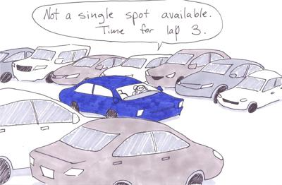
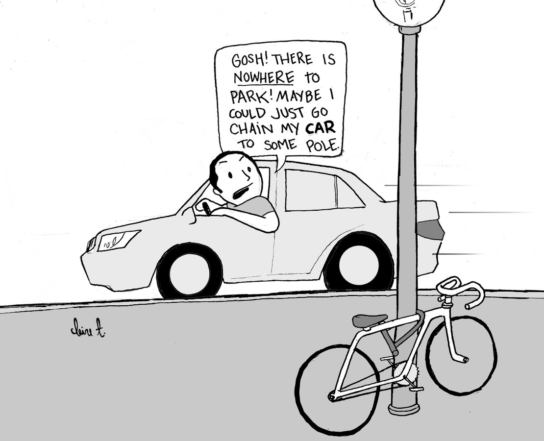
PARKING EXPERIENCES
Source: Northwest Missouri State University
Source: University of San Diego

Slide 4
UTC Parking Dynamics analysis using parking analytics

Slide 5
PROJECT OUTLINE
Motivation and Problem Statement
Literature Study
Project Scope
UTC Background Information
Analysis Methodology RQ1
Limitations and Assumptions
Data Review
Report & Results
Analysis Methodology RQ2 & 3
Data Review
Analysis Results
Conclusion and Recommendations
Future Potential Research Area
Comparative Cost Analysis

Slide 6
MOTIVATION:
Recognizing the limitations of traditional methods reliant on manual observations and subjective assessments.
I’m inspired by the transformative potential that analytical solutions can offer to an organization’s Decision making process.
PROBLEM STATEMENT:
UTC due to its prime location, exhibits unique land use patterns which project vast variabilities and complexities in the assessment of its parking usage.
There is a significant prior research around development of parking demand predictions models, However very little to no models around varied factorial affect analysis on Lot usage.
Determining and closing this gap is essential for enabling an informed direction towards optimizing parking management practices.

Slide 7
LITERATURE REVIEW

Slide 8



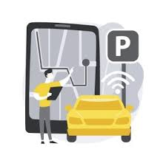
RELEVANT LITERATURE AREAS INCLUDE:
Prior studies on UTC parking.
Previous research investigations on parking lot utilizations.
Machine Learning Algorithms and Parking Management.
Smart parking sensors, technologies and applications for open parking lots.

Slide 9
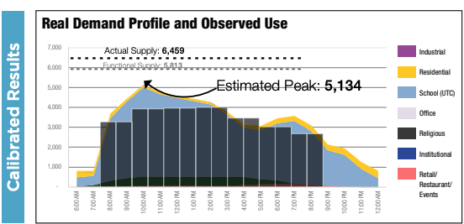
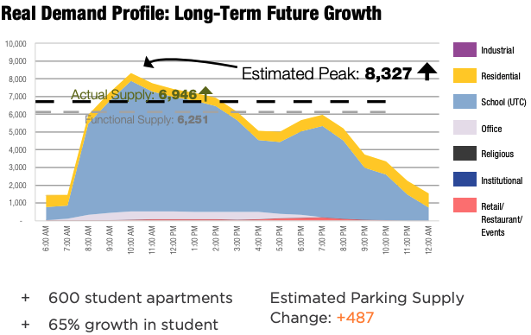
UTC Campus Area Findings (2018): Study by the CPA & River City Company.
The study was then considering UTC's 15,000 student growth as the biggest future traffic concern in this area.
The study points that UTC can only handle its future growth only with the implementation of right strategies.
Anticipated growth for the next 10years in parking supply and demand is as shown in Figure b.
What does the prior studies on
UTC Parking demonstrate?
Figure “a” Parking demand and use
Analysis compared information on supply (parking inventory), levels of use, and expected demand.

Slide 10
Previous research on Parking lot utilization. (Source in references)
Temporal Factors (A)
Spatial factors (B)
User factors (C)
(A) | (B) | (C)
Peak Hours | Central campus Lots | (Staff, student, faculty, visitors) Schedules
Days of the week | Peripheral Lots | Commuting Habits
Semesters( Fall vs spring) | Proximity of blocks to lots on campus | User Permit Type
Events
LOT UTILIZATION
TABLE: 1

Slide 11
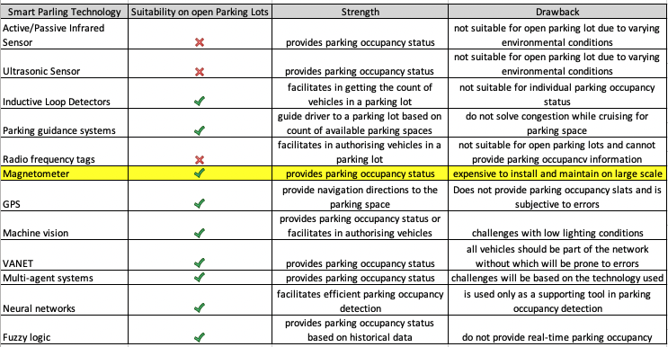
Overview of available Smart Parking Technologies for open parking lots.

Slide 12
AIM:
To identify factors primarily influencing UTC Parking Lot usage & build predictive utilization classification model which can be deployed to empower parking management and monitoring practices at UTC.
OBJECTIVE:
To answer the following research questions in the paper:
RQ 1: Investigating the general projected parking dynamics at UTC campus.
RQ 2: Identifying the factors affecting the Lot utilization rate at UTC.
RQ 3: Identifying which machine learning algorithm fits best to accurately predict the parking utilization class?

Slide 13
PROJECT SCOPE
DELIVERABLES
OUTPUT- Qualitative prediction models that can be deployed on the parking management server for efficient handling of recorded data, enabling data-driven insights.
BOUNDARIES
The developed models are based on historical data and therefore the deployment on real time data is beyond the scope for this project.
The ADA Accessibility and visitor parking Lots are omitted, because of limited data & is beyond the scope of this project.

Slide 14
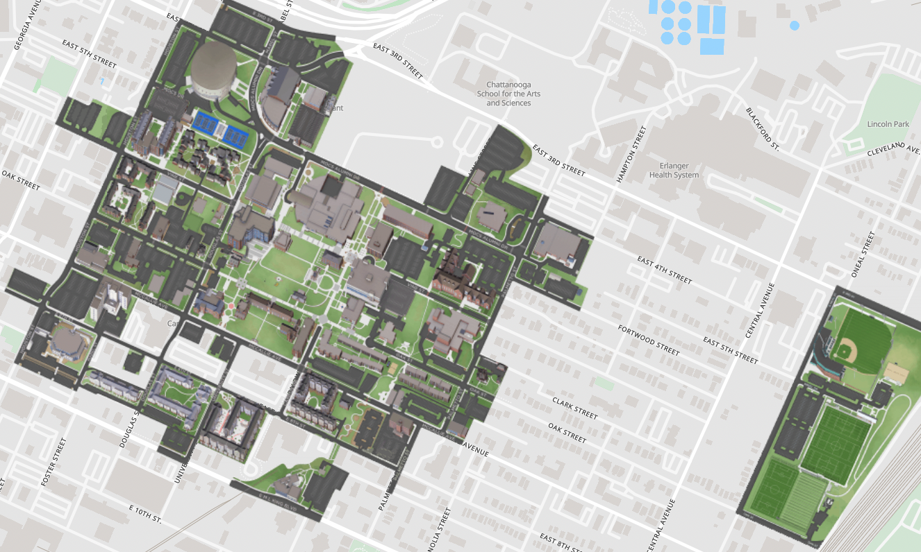
CASE AREA BACKGROUND
UTC is a metropolitan university that is spread across 145 acres of land with over 90 buildings including administrative, academic, residential, and athletic facilities on campus.
It has an enrollment of approximately 11000 students and 1075 faculty members.
UTC Parking Map

Slide 15
UTC Parking Information
The UTC parking services are managed by the University's Parking Services Department.
The campus has a total of 6117 parking spaces.
The total parking spaces for each category of is as summarized in Table 2.
PARKING TYPE | TOTAL SPACES
Reserved | 3167
General | 2569
Visitor | 211
Accessible | 170
TABLE: 2
UTC Parking Map

Slide 16
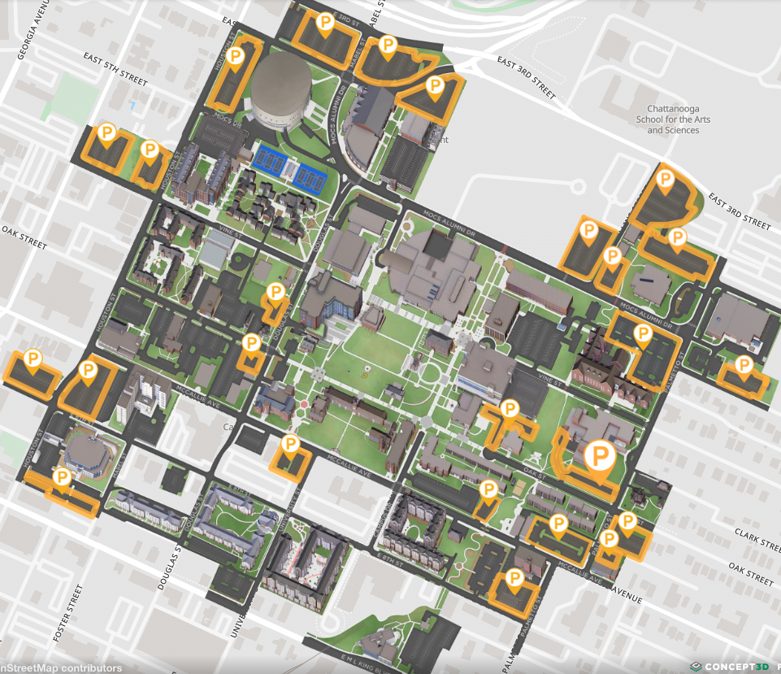
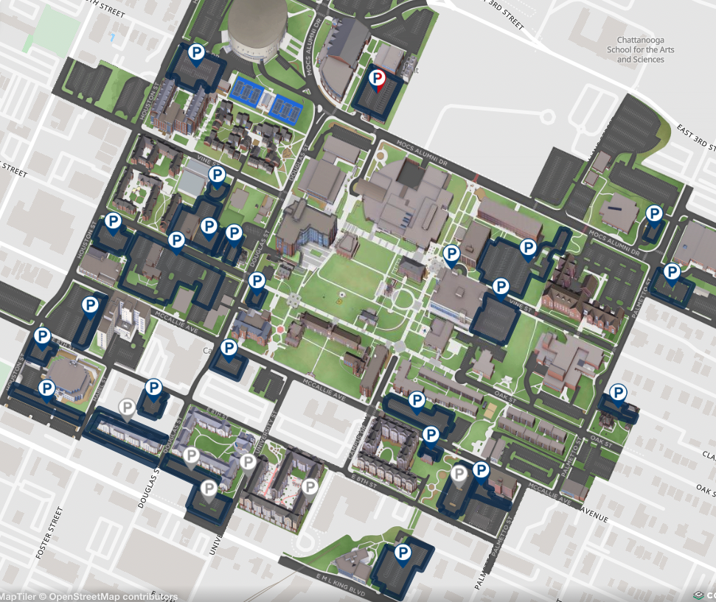
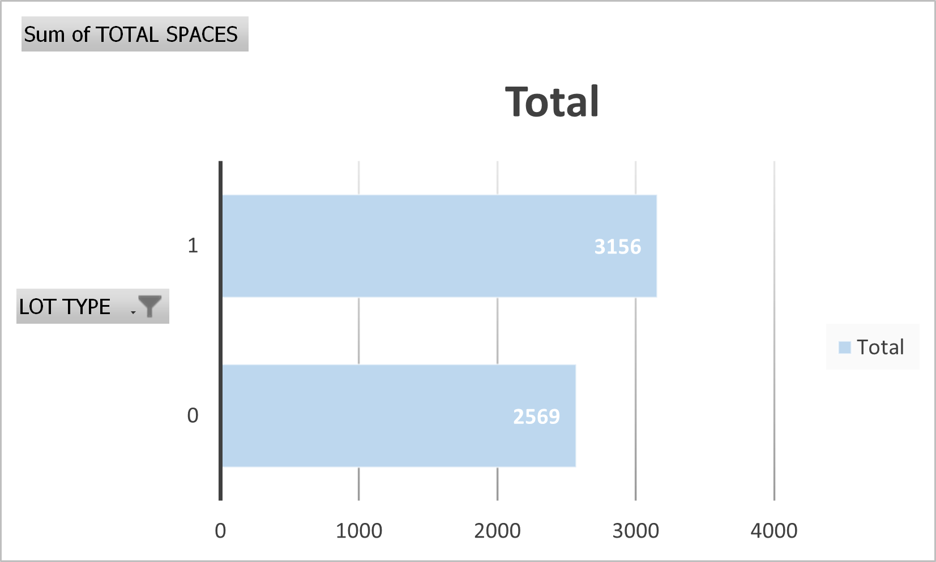
Additionally, in Fig.1&2, the general parking lots are indicated in yellow and the reserved parking lots are indicated in blue for reference.
FIG. 1
1- Reserved
2- General
FIG. 2

Slide 17
ANALYSIS METHODOLOGY
PHASE 1
PHASE 3
DATA ANALYSIS
Understanding the affecting factors through Diagnostic Analysis.
Developing Predictive models using Machine learning Algorithms.
DATA COLLECTION
Gathered from - UTC parking department, Geographic Information System(GIS) department and The planning evaluation and institutional research department.
The data gathered contains Temporal, spatial and user attributes around Parking Utilization at UTC.
PHASE 2
DATA PREPARATION
Removing major errors, duplicates, and outliers.
Removing unwanted data points.
Bringing structure to the data.
Clubbing all the data together.
All the above are performed using Alteryx tool
PHASE 4
SUMMARIZE KEY FINDINGS
Interpreting the output Report for insights on UTC parking factors and identifying best algorithm that delivers highest accuracy.

Slide 18
ANALYSIS METHODOLOGY (cont’d)- To answer RQ 1
Consolidate building occupancy and parking lots data.
Use Spatial Analysis- to determine the no of buildings within 0.11miles distance for each parking lot on campus.
Based on that create new attributes and added to the dataset.
Clean & handle data for missing values, errors using Alteryx tool.
Assign data types for each attribute based on their observations type.
Create samples of the data to divide them into training(80%) and testing sets(20%).
Conducted Logistic regression analysis for two different models for Lot utilization at 80% and at 90% to find the commonly projected insights.

Slide 19
LIMITATIONS AND ASSUMPTIONS
Event occurrences and weather conditions which may influence variable relationships, are not included in the dataset.
The models are constructed using historical data, potentially affecting accuracies due to the absence of real-time information.

Slide 20
DATA REVIEW
TABLE: 4
VARIABLES | DESCRIPTION
Year (x₁) | 2018,2019 and 2022.
Weekdays (x₂) | Monday- Friday.
Lot Type (x₃) | Reserved and General lots.
Time (x₄) | Time stamps (9:30,12:30.13:30,15:30)
Loc Type (x₅) | Type of buildings within the campus.
Max-find nearest (x₆) | No of blocks within 0.11 miles of each parking lot.
Sum student occupants (x₇) | No of occupants.
90% & 80% Utilization rate (x₈) | Lots at 90% and 80% utilization.
The analysis focuses on how the independent variables corresponds to Lot Utilization (dependent) at UTC.
The logistic regression type allows to analyze
& model the relationship between the independent & dependent binary variable.
The Regression Analysis is performed using Alteryx tool.
Independent Variables
Dependent Variable

Slide 21
LOGISTIC REGRESSION ANALYSIS RESULTS
Predicted Insights based on both the models about Lot Utilization at UTC.
LOT UTILIZATION
VARIABLES
Weekdays (x2)
Lot Type (x3)
Time (x4)
Loc Type (x5)
HIGHEST
Lowest
Monday
Wednesday
Tuesday
Thursday
GENERAL
RESERVED
11:30 A.M
3:30 P.M
X1127
X1115
X1116
FIG. 3

Slide 22
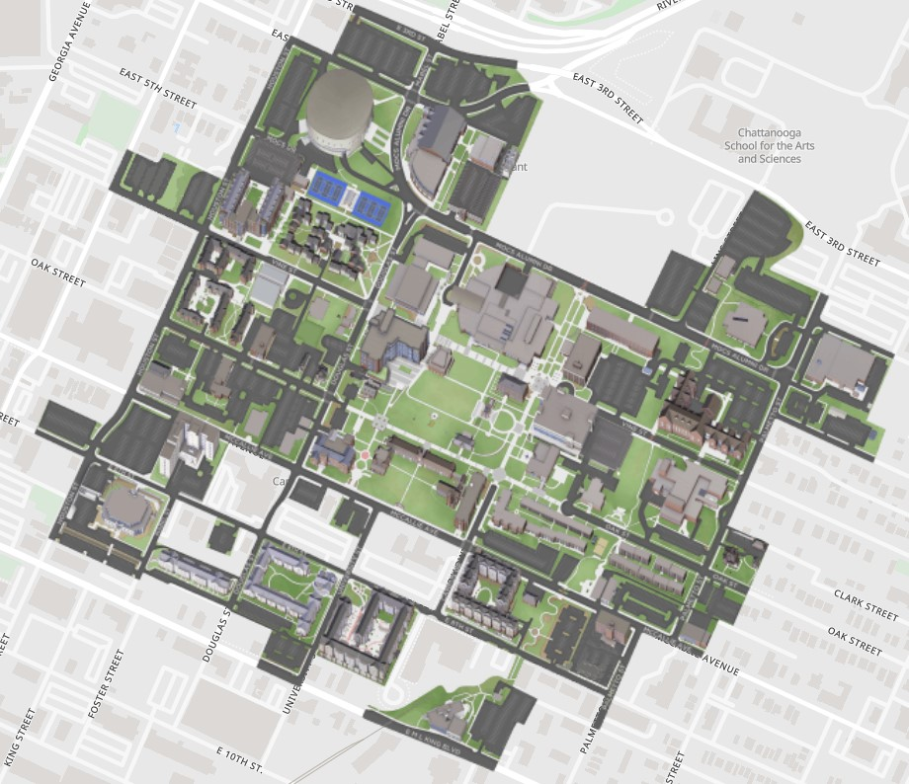
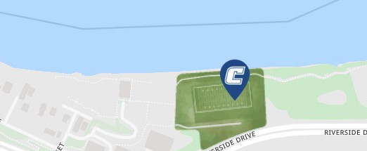
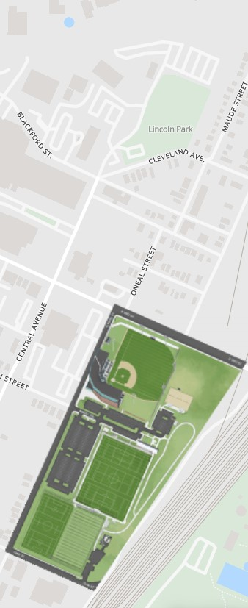
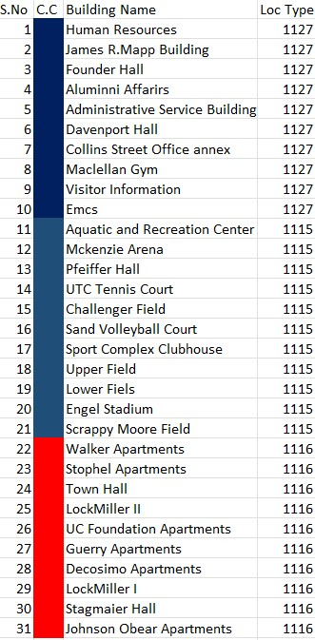
21
12
11
14
31
9
8
7
15
5
6
4
10
3
20
2
30
13
20
16
27
25
18
28
26
1
19
17
22
23
2
FIG. 4
Results: Identified Blocks in the campus impacting parking Lot utilization

Slide 23
ANALYSIS METHODOLOGY (cont’d)- To answer RQ 2 & 3
Consolidate building occupancy and parking lots data.
Use Spatial Analysis- to determine the no of buildings within 0.11miles distance for each parking lot on campus.
Based on that create new attributes and added to the dataset.
Clean & handle data for missing values, errors using Alteryx tool.
Assign data types for each attribute based on their observations type.
Create samples of the data to divide them into training(80%) and testing sets(20%).
Developed predictive classification model using Forest Model, Decision Tree and Neural Network algorithms to determine which model delivers optimum accuracy and to identify the affect of predictors variables on Lot Utilization.

Slide 24
DATA REVIEW
VARIABLES | DESCRIPTION
Year (x₁) | 2018,2019 & 2022.
Weekdays (x₂) | Monday- Friday.
Lot Type (x₃) | Reserved, General
Time (x₄) | Time stamps 9:30,12:30.13:30,15:30
Building Type (x₅) | AA, RH, SR, OB.
Max-find nearest (x₆) | No of blocks within 0.11 miles of each parking lot.
Building occupancy (x₇) | No of occupants.
Lot Utilization (x₈) | Full, High, Moderate, & low
BUILDING TYPE | DESCRIPTION
AA | Administration & academics
RH | Residence Halls
SR | Sports & Recreation
OB | Other Buildings
Predictor Variables
Table 8

Slide 25
DATA REVIEW
Table 1.
LOT UTILIZATION CATEGORY | DEFINED THRESHOLDS
Full | >95%
High | Lot utilization > 0.65 but less than equal to 0.95
Moderate | Lot utilization > 0.35 but less than equal to 0.65
Low | <= 0.35
Table 9: Formulation of additional attribute and their thresholds as stated

Slide 26
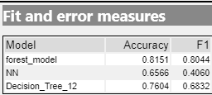
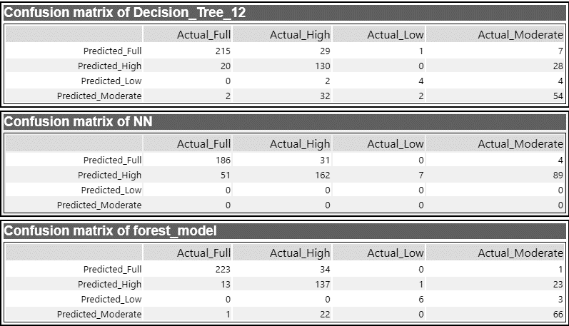
ANALYSIS RESULTS- RQ2
The Training process used the lowest no of nodes and hidden layers to observe the performance of the models. The forest model displayed highest accuracy of 81%, while NN model resulted with least accuracy of 65%.
Forest Model delivered better accuracy in classifying Lot usage.
Table 10: Model Comparison
Table 11: Confusion Matrix of all 3 Models

Slide 27
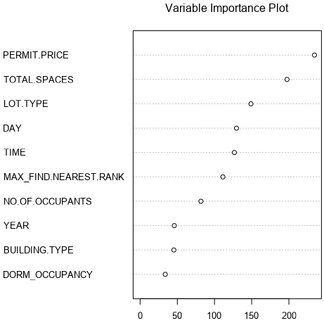
EXPERIMENT 2 RESULTS
The answer to RQ2 is as presented in Figure.
Strong Influence
Weaker Influence
Table 12: Variable Importance

Slide 28
CONCLUSIONS
Relying solely on subjective assessments to formulate parking strategies, particularly in large-scale university settings, can lead to inefficiencies and potential problems in the overall campus experience.
These traditional methods often lack the precision and scalability needed to effectively manage parking needs.
By leveraging data-driven insights and deploying predictive models on the parking management server, universities can optimize parking operations, enhance utilization of parking spaces, and ultimately improve the campus experience.

Slide 29
Recommendations
Potential Focus Areas that UTC Parking department may consider Strategizing upon would be:
Permit Pricing policies- May be consider dynamic pricing in the future by grouping Lots with peak utilization.
Implement Smart parking technologies that can efficiently capture UTC parking data to enhance their parking monitoring and management practices.

Slide 30
FUTURE POTENTIAL RESEARCH AREA
UTC Limitations observed during this study is :
The predictive model is developed on historical data.
No Access to capture real time Parking data.
Limited efficient parking technologies.
Traditional monitoring and Management practices.
Limited Land availability for further expansions

Slide 31
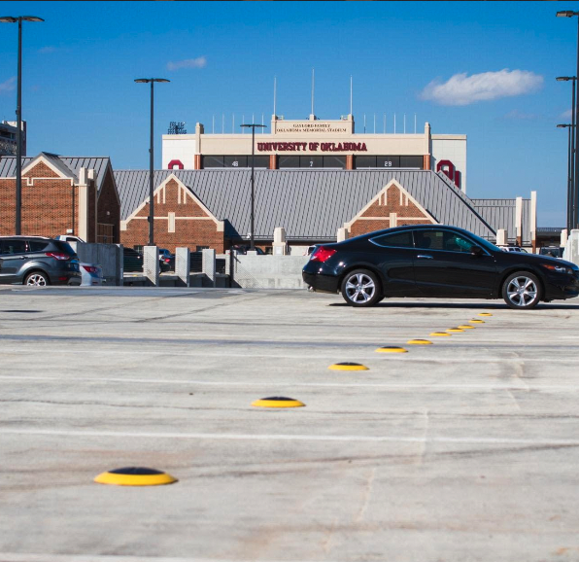
Potential strategy-Integrating Smart Sensor Technologies
To overcome the present limitations & build for future UTC may consider investing in Smart technologies.

Slide 32
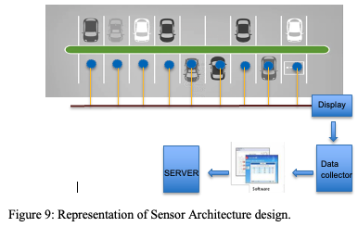
Integrating Smart Sensor Technologies
Recommended Design:
The proposed system is a wireless sensor network with a data collector. This system is designed to gather information from sensors spread over a wide area and transmit that data to a central location for processing and analysis.

Slide 33
Components of the proposed system
Magnetic & ultra sonic sensors
Display Screen (Optional)
Relay nodes (optional)
Data Collector
Parking software deployed on server

Slide 34
Advantages of proposed system
Allows for capturing real time occupancy data.
Expected life time is around 5-9 years.
Simplified parking Management and Monitoring Practices.
Cost efficient over building new parking facilities.

Slide 35
Comparative Cost Analysis between Sensor technology and Building new parking facility
S.NO | Description | Price per unit | Total cost
1 | Sensor cost | $278 | $139000
2 | Installation cost | $30 | $15000
3 | Display unit | $600 x 45 no’s | $27000
4 | Parking Application software | $18000 | $18000
8 | Relay nodes | $500X10 | $5000
 |  |  | $204000
Specifications
Sensor- Sensit surface mount
1 relay per 50 sensors
Wireless technology
Battery life – 5 to 9 years

Slide 36
Cost Breakdown for building 500 spaces parking facility.
S.NO | Description | Price per unit | Cost for 500 spaces
1 | Cost per space | $25000
2 | Engineering Fee | 5% | $625,000
3 | Soft Cost Lawyers, insurance, permits | 5% | $625,000
4 | Design Fee | 3% | $375,000
8 | Equipment cost | 7% | $875,000
9 | G.C Fee | 15% | $1,875,000
10 | Labor cost | 30% | $3,750,000
11 | Material cost | 35% | $4,375,000
 |  |  | $1,250,0000
Source

Slide 37
CONCLUSION
To conclude Parking Management and monitoring services play a pivotal role in shaping an efficient campus experience.
As campuses continue to evolve, investing in robust Parking Monitoring solutions remains essential for fostering a seamless and enjoyable environment conducive to learning, collaboration, and growth.

Slide 38
FUTURE AREA OF STUDY
This study could be further expanded in the direction of integrating the recommended design with an IOT application that is exclusively developed for UTC parking and its users.
This can allow for a simplified and efficient Parking management systems for both the parking department and the users at UTC and enhance overall campus experience.

Slide 39
Thanks!
ANY QUESTIONS?
You can reach me at
@tejaswini adari
SZP533@mocs.utc.edu

Slide 40
[1] Park, J., Youn, S., & Kim, S. (2015). Real-time parking availability prediction using machine learning. Expert Systems with Applications, 42(12), 5630-5638.
[2] Li, Y., Gong, L., Liu, S., & Wang, X. (2017). Parking occupancy prediction for university campuses using machine learning: A case study. Transportation Research Part C: Emerging Technologies, 79, 374-387.
[3] Chen, S., Wang, W., Li, X., & Liu, X. (2018). A parking lot allocation system with user classification for university campuses. Transportation Research Part C: Emerging Technologies, 86, 318-332.
.
Bibliography:

Slide 41
[4] Cao, J., Ma, X., & Zhou, H. (2019). A comprehensive parking demand analysis considering various factors: A case study in a university campus. Sustainable Cities and Societies, 48, 101598.
[5] Schaller, B. (2018). Street smart: The confluence of changing consumer behavior and disruptive technology. Island Press.
[6] Chen, S., Wang, W., Li, X., Liu, X., & Wang, F. (2020). A multi-objective parking space allocation optimization method for university campuses. Computers & Industrial Engineering, 147, 106682.
[7] Zhou, Y., Sun, Y., Guo, Y., & Liu, Y. (2020). Deep learning for real-time parking occupancy detection with wide-area aerial images. IEEE Transactions on Intelligent Transportation Systems, 21(11), 5229-5241.
[8] Qin, Z., Yu, L., Liu, Y., & Wang, X. (2019). A survey of intelligent parking systems based on wireless sensor networks. IEEE Access, 7, 138047-138071

Slide 42
Economic Analysis refrence-
https://www.fixr.com/costs/build-parking-garage#traditional-vs-precast-garage-cost
M. S. Smith and T. A. Butcher, "How Far Should Parkers Have to Walk?" 2008 [Online]. Available: http://worldcat.org/oclc/3041176.

